Slide 1

Introduction to
Java Web Application Development

Slide 2
Prequisites
  Completed:
  PRO192 (OOP with Java)
  DBI202 (Database Systems)
  WED201c (Web Design for Everybody)

Slide 3
Course Objectives
This course explores the features of Java web technology
  Understand and proficienly the core technologies of Java web programming : Servlets, JSP, Filter
  Understand and apply web extension technologies: EL, JSTL, Custom Tag
  Understand and apply session management, event handling, and data sharing on web servers
  Understand and apply JDBC programming in web application
  Understand and be able to apply MVC architecture for developing and deploying Java Web Application

Slide 4
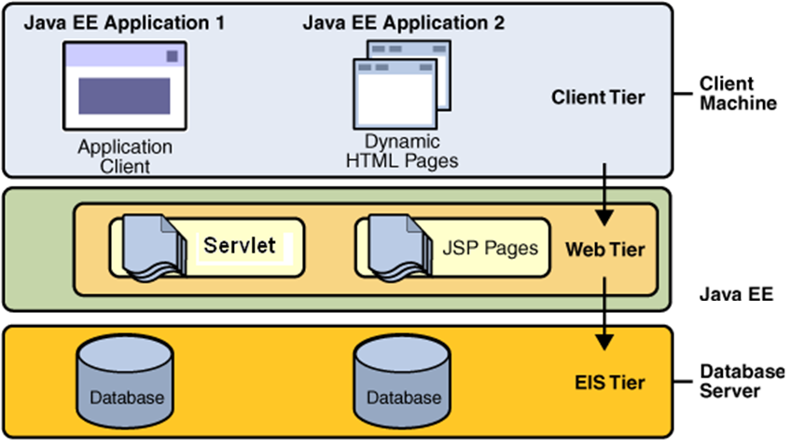
Course Overview

Slide 5
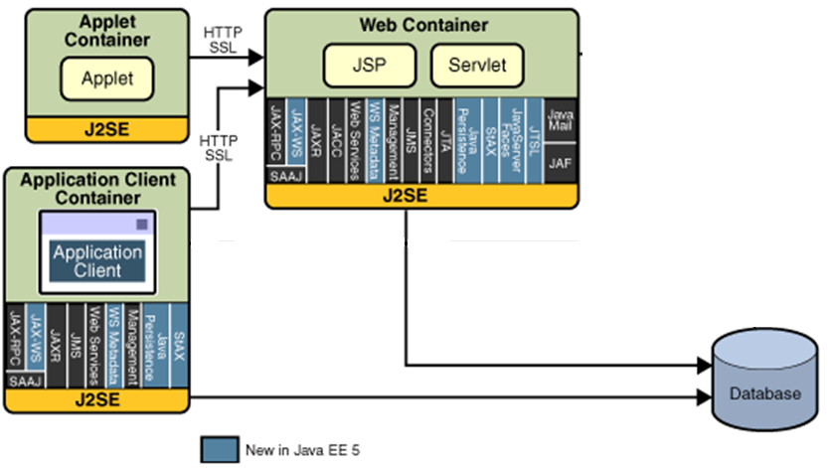
Course Overview

Slide 6
Course Description
HTTP and Web application
Introduction to Java web application
Servlet introduction
Java Server Pages
Web application with JDBC
Java Bean in JSP
MVC architecture introduction
Session - Application Management
Expression Language
JSP Standard Tags Library
Web Server Event Handling
Custom Tags
Filter

Slide 7
Materials/ References
Required Textbook
  Online Text book: Nicholas S. Williams, 2014, Professional Java® for Web Applications, Wrox Press
  http://library.books24x7.com/toc.aspx?bookid=62587
References
  http://docs.oracle.com/javase/tutorial/JDBC/
  https://docs.oracle.com/cd/B14099_19/web.1012/b14017/filters.htm
Slides on web
  http://lmsdn.fpt.edu.vn
  https://flm.fpt.edu.vn/

Slide 8
Learning Environments
JDK 8 - http://www.oracle.com/technetwork/java/index.html
NetBeans IDE 7.4/8.0.2/8.1/8.2 – full package
DBMS: MS. SQL Server
Browser: Chrome
JDBC Driver for MS. SQL Server: sqlserver4.jar

Slide 9
Course Rules
How to conduct
  Prepare contents of the next session/ topic at home
  Following lessons in classrooms
  Completing chapter assessments in time and Quizzes (via LMS)
Communication
  Discussing actively in your teams and in classrooms edunext.vn
  Free to question and answer
Others
  Off phone - Use laptops under teacher’s instruction

Slide 10
Evaluation Scheme
Must attend more than 80% of contact hours
Evaluating
  02 Progress Test (Q) 10 %
  02 Workshop (Lab) 10 %
  01 Assignment (Prj) 40 %
  01 Practical Exam (P) 20 %
  Final Exam (FE) 20 %
GPA: 10% (Q) + 10% (Lab) + 40% (Prj) + 20% (P) + 20% (FE)
Pass
  Total score ≥ 5 and Final Examination ≥ 4 (of 10)
  Every components > 0
Retake only the Final Exam when not passed

Slide 11
Academic policy
Cheating, plagiarism are serious offenses.
  Cheating
    Cheating during a test, doing project, or an exam is construed as talking, peeking at another student’s paper, or any other clandestine method of transmitting information.
    To verify, student’s code in project can be deleted, then he/she must be retyped to make the program running correctly. Or/And make new required functions (Otherwise, he/she takes 0 marks for his/her project/quiz)
  Plagiarism
    To verify, student must be described functionality dataflow and how it work (Otherwise, he/she takes 0 marks for his/her project)

